Slide 1
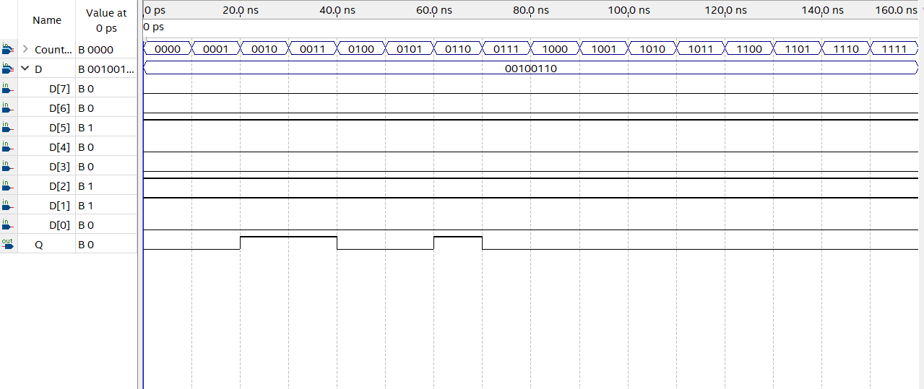
input
output
0
1
1
0
0
1
0
0
Initialization
Start to transmit

